Slide 1

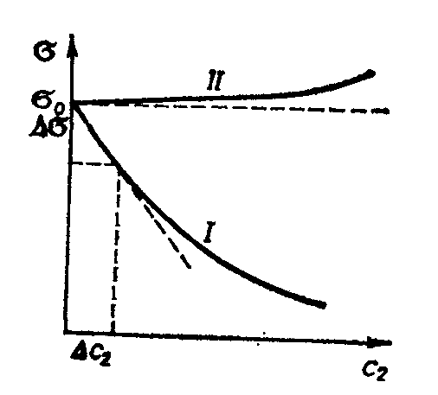

Lecture 5 Surfactants and surface inactive substances.
Classification of surfactants. Micellization of surfactants.
Figure 1 (lecture 4). Dependence of a surface tension on concentration of surface-active (I) and inactive (II) substances.
(I)
(II)
diphilic substances show strong surface
activity with respect to water
Adilbekova A.O

Slide 2
Substances that lower the surface tension of the system (dσ/dc< 0) are referred to as surface active substances, or surfactants.
It follows from the Gibbs equation that the adsorption of such compounds is positive, i.e. their concentration within the surface layer is higher than that in the bulk.

Slide 3
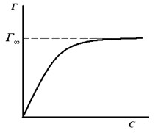

Substances that increase the surface tension of solvent are referred to as surface inactive. (mineral acids and alkali)
There are also examples of cases where solutes do not cause
any detectable change in the surface tension of solvent, as occurs in, e.g., an aqueous solution of sugar.

Slide 4
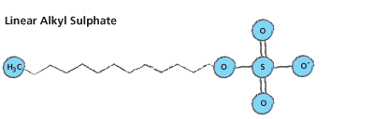
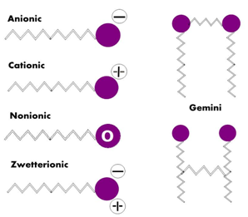
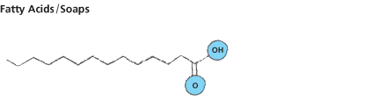
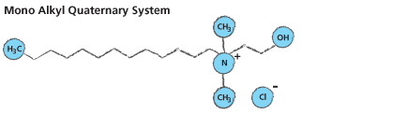

Slide 5
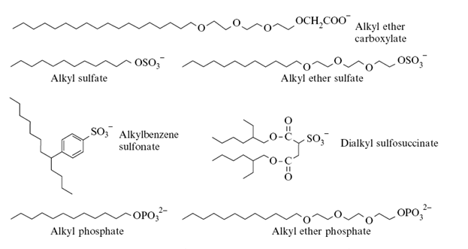
Anionics

Slide 6
Cationics

Slide 7
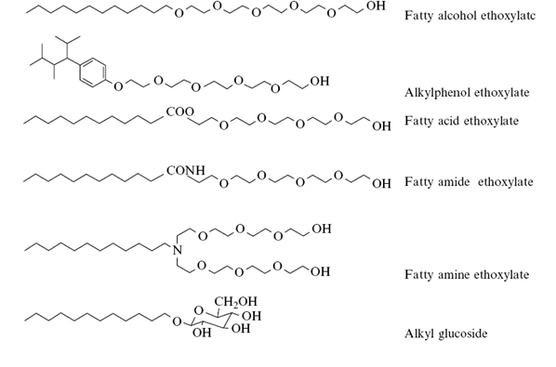
Non-ionics

Slide 8
Amphoteric and Zwitterionic surfactants

Slide 9
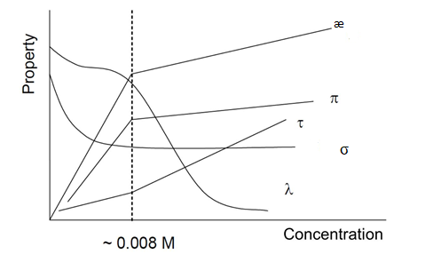
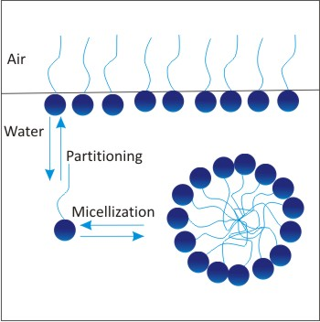
The change in some physical chemical properties of sodium dodecylsulphate (SDS) as a function of SDS concentration. æ – specific electroconductivity, π – osmotic pressure, τ – turbidity, σ – surface tension, λ – equivalent electroconductivity of SDS solution

Slide 10
Questions?
Thank you for your attention!

